Slide 1

Movie Recommendation Systems
Movie Recommendation System
Sreeniketh Aathreya: spa44
Dhruvil Mehta: dm1610
Darshan Senthil: ds1992

Slide 2
Agenda
Project objective
Understanding the problem
Overview
Recommendation Types
Dataset
Data Preprocessing
Methods
Metrics
Conclusion

Slide 3


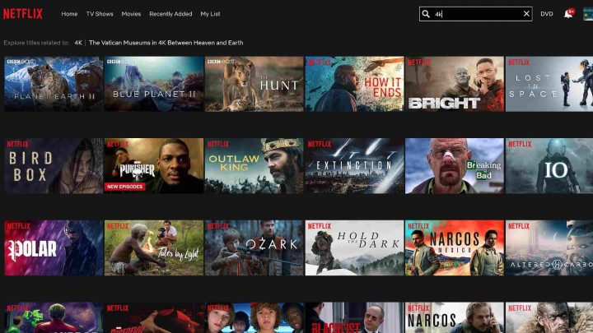
Project objective
The objective of the movie recommendation system project is to build a machine learning model that can predict movie recommendations for users based on their historical movie ratings.
The dataset used for this project will contain movie titles, user IDs, and ratings. The evaluation of the model will be based on the RMSE and MAE metrics.
The ultimate goal of the project is to provide users with a more enjoyable movie-watching experience by helping them discover new movies that they might be interested in based on their preferences.

Slide 4
Understanding the problems
01
Information overload: Movie platforms often have a vast library of movies, making it difficult for users to find movies that they might be interested in. Recommendation systems can help by providing personalized recommendations based on the user's viewing history.
02
Limited ratings: Users on movie platforms may only rate a small subset of movies, which can make it difficult to build accurate models for recommendation. Recommendation systems can help address this by using collaborative filtering techniques, which rely on the ratings of other similar users to generate recommendations.

Slide 5
Understanding the problems
03
Cold start problem: New users on movie platforms may not have enough ratings or viewing history to generate personalized recommendations. Recommendation systems can address this problem by using content-based filtering techniques, which rely on the characteristics of the movies themselves to generate recommendations.
04
Popularity bias: Movie platforms may tend to recommend popular movies over lesser-known movies, which can limit the diversity of recommendations. Recommendation systems can address this by using hybrid filtering techniques, which combine collaborative filtering and content-based filtering to generate more diverse and personalized recommendations.

Slide 6
Overview
The recommendation system is built to predict the movies that a user might like based on their historical movie ratings. The model should take into account the user's previous ratings, as well as the ratings of other users who have similar taste.
The system will use three different algorithms to achieve this goal: Singular Value Decomposition (SVD), K-Nearest Neighbors (KNN), and Slope One. SVD will be used to predict missing values in the user-movie rating matrix, KNN will be used to find similar users based on their ratings, and Slope One will be used to generate personalized recommendations based on the user's historical ratings.
The project will require cleaning and preprocessing of the data, as well as splitting the data into training and testing sets.

Slide 7
Recommendation Types
01
Content-Based Filtering: This technique recommends movies similar to the ones a user has liked in the past based on attributes like genre, actors, directors, and keywords.
02
Collaborative Filtering: This technique recommends movies based on the behavior of other users who have similar preferences as the current user.
Collaborative filtering can be further divided into two types:
User-based: Recommendations are made based on the movies liked by similar users.
Item-based: Recommendations are made based on the movies that are similar to the ones the user has already watched.
03
Hybrid Recommendation: This technique combines both content-based and collaborative filtering to provide more accurate recommendations. Hybrid recommendation systems are usually more effective than individual techniques.

Slide 8
Dataset
The MovieLens 1M dataset was used in this project.
The dataset contains 1 million ratings from 6000 users on 4000 movies.
All ratings follow a numerical scale of 1 (bad) to 5 (excellent).
The original dataset was split into five distinct splits for training and testing purposes.
Each user was considered individually, and 80% of their ratings were randomly selected as training ratings.
The remaining 20% of ratings were used as testing ratings.
80%
20%
Training split
Testing split

Slide 9
Data Preprocessing
02
Data Collection
Data Cleaning
Collect data about movies, such as movie titles, genres, release dates, cast and crew, ratings, and reviews
Clean the data to remove any irrelevant or missing values.
01
03
Data Splitting
Data Reduction
Split the dataset into training and testing sets to evaluate the performance of your recommendation system.
Reduce the size of the dataset by removing redundant or irrelevant features.
04

Slide 10
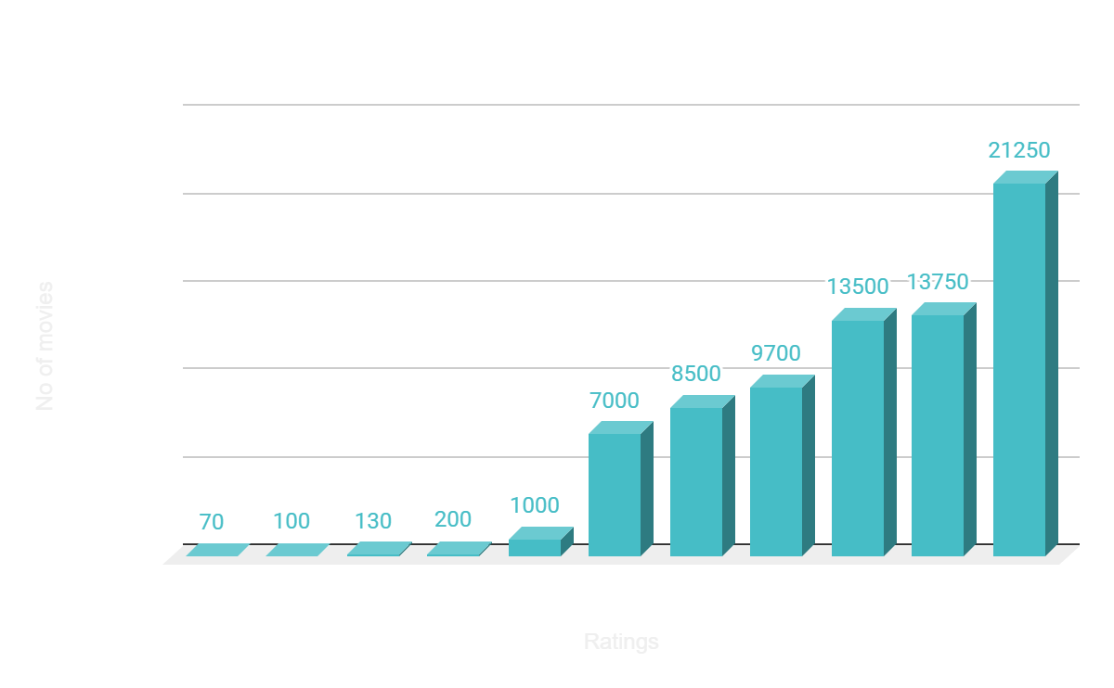
Frequency of Rating

Slide 11
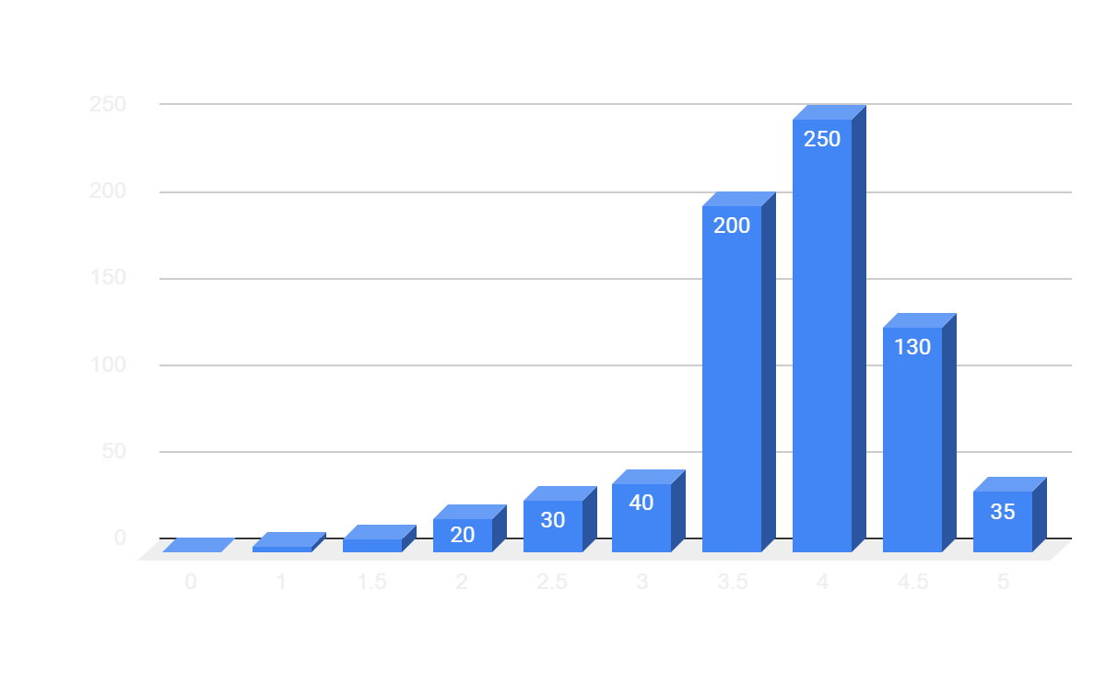

Slide 12
Methods
01
Singular Value Decomposition (SVD): It is a matrix factorization technique used in movie recommendation systems to reduce the dimensionality of the user-item interaction matrix and provide personalized recommendations based on user preferences.
02
K-Nearest Neighbors (KNN): It is a collaborative filtering algorithm used in movie recommendation systems to find similar users or items and recommend movies to a user based on their neighbors' preferences.
03
Slope One: It is a simple yet effective collaborative filtering algorithm used in movie recommendation systems that calculates the average difference between ratings of two items and uses it to predict a user's rating for an item.

Slide 13
Metrics
RMSE
MAE
Precision
F-Score
Recall
NDCG
Root Mean Square Error is a measure of the difference between the predicted and actual ratings for movies in the recommendation system.
Mean Absolute Error is similar to RMSE, but measures the average absolute difference between the predicted and actual ratings.
Precision is the proportion of recommended movies that the user actually likes.
F-Score is a measure of the recommendation system's accuracy that balances both precision and recall.
Recall is the proportion of the user's liked movies that were recommended by the system.
Normalized Discounted Cumulative Gain measures the quality of the ranked recommendations, taking into account both relevance and ranking position.

Slide 14
Results
Metrics | SVD | K-NEIGHBOURS (BASIC) | K- NEAREST NEIGHBOURS (MEANS) | SLOPE ONE
RMSE | 0.8699 | 0.9332 | 0.9113 | 0.8986
MAE | 0.6684 | 0.7149 | 0.7042 | 0.6911
F- SCORE | 0.4121 | 0.3802 | 0.3886 | 0.4112
PRECISION | 0.8842 | 0.8274 | 0.8934 | 0.8695
RECALL | 0.2687 | 0.2483 | 0.2483 | 0.2692
NDCG | 0.8999 | 0.8938 | 0.8898 | 0.8916

Slide 15
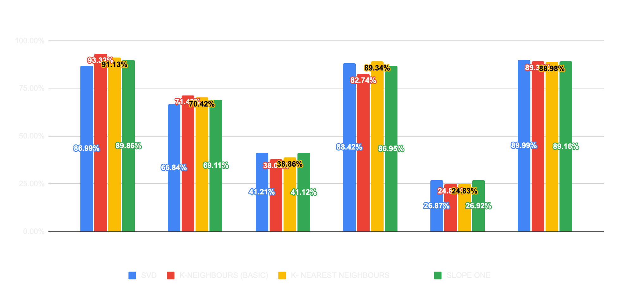

Slide 16
Conclusion
It can be observed that SVD yields the lowest RMSE and MAE values among the four models evaluated. The next highest values are obtained by K-Nearest Neighbours (with means), while K-Nearest Neighbours (Basic) has the highest RMSE and MAE values. The F-score values for all four models are quite similar. With regard to precision, SVD exhibits the highest value, whereas K-Nearest Neighbours (Basic) demonstrates the lowest precision. On the other hand, K-Nearest Neighbours (with means) has the highest recall, while SVD has the lowest. The F-score, which is an average of precision and recall when they are close, is also quite similar for all models, although K-Nearest Neighbours (with means) has the highest value. Therefore, based on the lowest MAE and RMSE values, it can be concluded that SVD is a superior model compared to Slope-one and both versions of K-Nearest Neighbours.

Slide 17


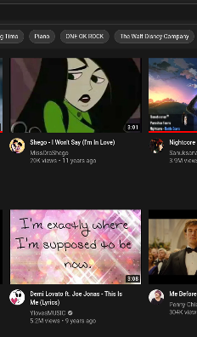


Thank you!

